Slide 1
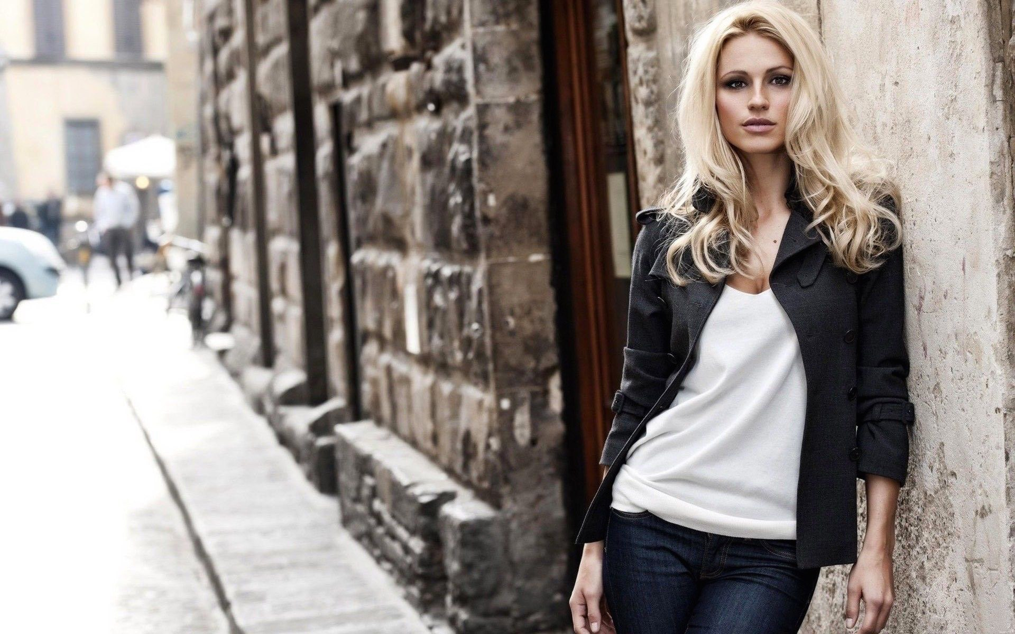

SMART
Closet
beta

Slide 2
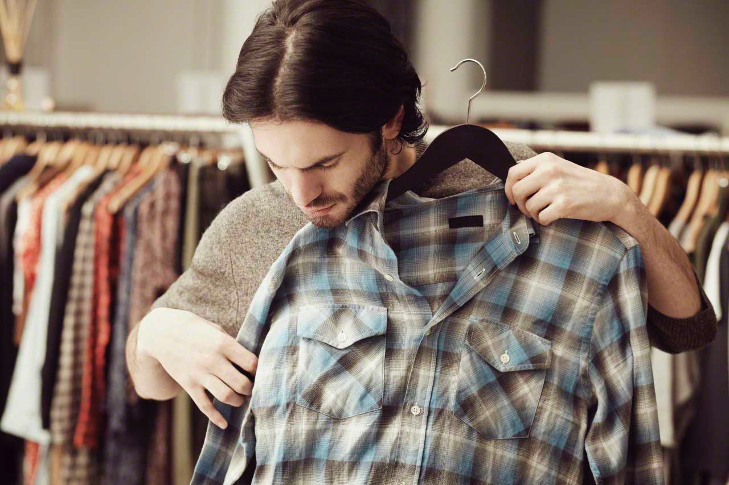
What the F**K do I wear today?

Slide 3
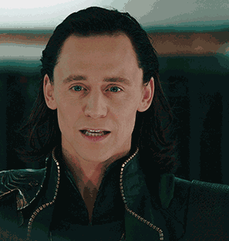
What if…??
An app knew all the clothes in your closet?
The app could choose those combinations that match better?
The app could recommend you about new products that match clothes you already have?

Slide 4
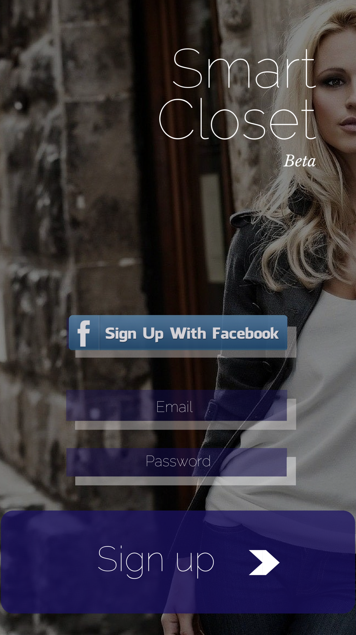
solution

Slide 5
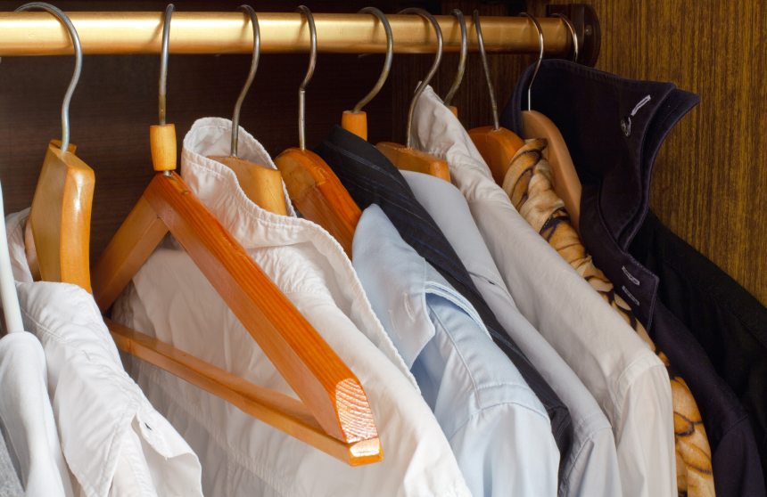
What does Smart closet do?
It tracks all your clothes (in your closet and in laundry).
The algorithm recommends you what to wear according to the event.
Recommends you what to buy to match your existing clothes.
Integrated with retail online stores/ weather apps/ google calendar.

Slide 6
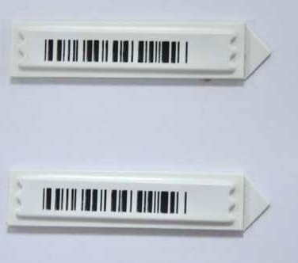
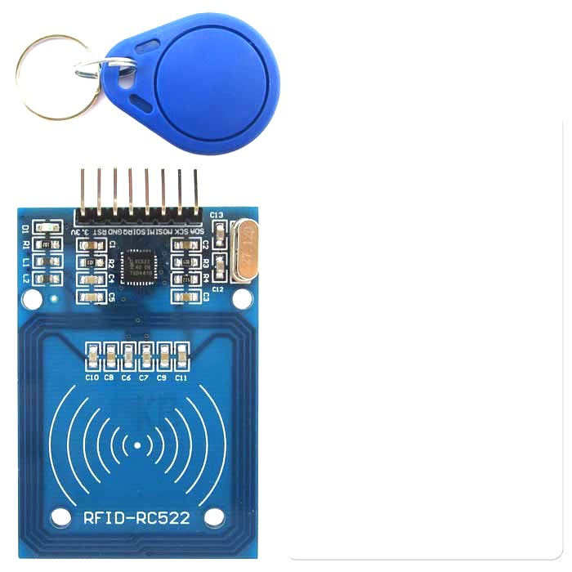
The technology
RFID technology is already included in the tags of clothes
Zara, Mango and other companies uses it to monitor real time their stock.
By installing a small reader in your closet you can connect your closet with your smartphone.
The information goes to the app that offer your recommendations.

Slide 7
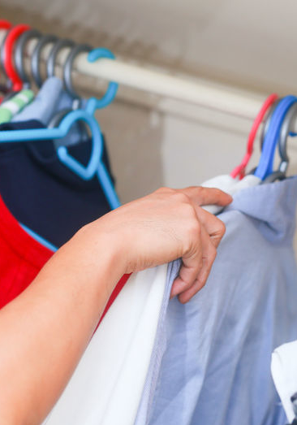
How does it work?
Bring the RFID label close to the reader within your closet for check in and check out your clothes.
Everytime new clothes are introduced, the app saves them and the algorithm creates new combinations.
The algorithm gives you automatic recommendations of new products.

Slide 8
https://popapp.in/w/projects/572486fbbb163c267576b35b/preview
Smart Closet prototype

Slide 9

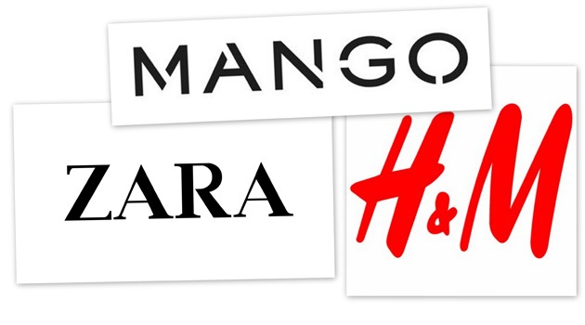
Customers
The app user: Young professionals with busy life living in urban areas.
The Brands: Big retail brands already using RFID technology (Inditex, Mango, H&M, Primark…)

Slide 10
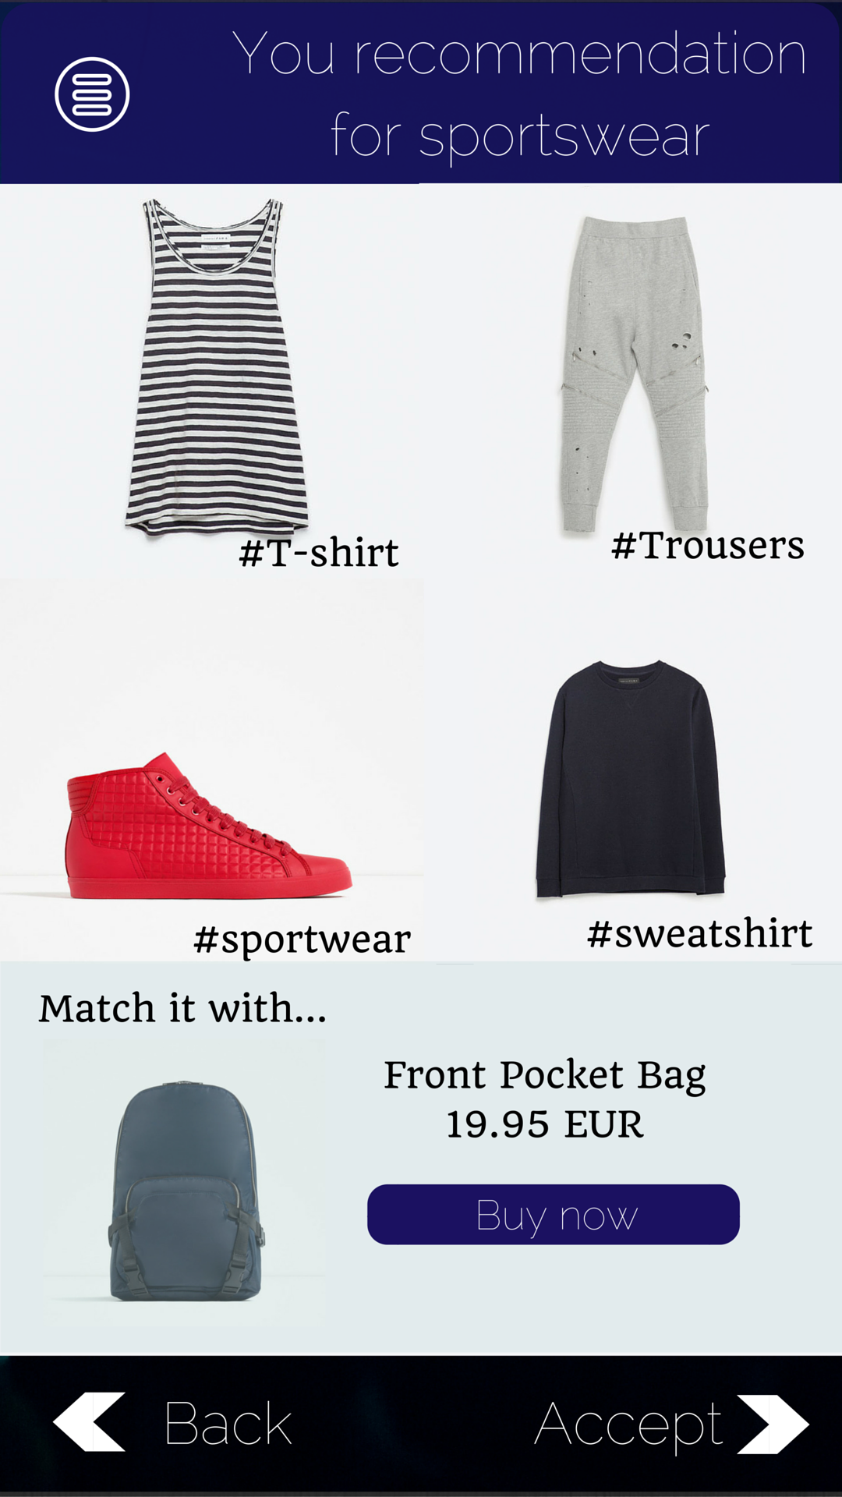
BenefitS
Extra revenue from cross-selling and recommendations like Amazon does (who increased 33% the benefit with this strategies)
Measure behaviours and habits of the customers, thanks to the IoT and wearables technology.
Apply all the big data collected to business intelligence, in order to predict demand and trends, thanks to machine learning, and the smart advisors.

Slide 11
BenefitS
Being partner of Smart closet, give you the possibility to know more about competitors, because we track all the clothes from people’s closets from different brands.

Slide 12
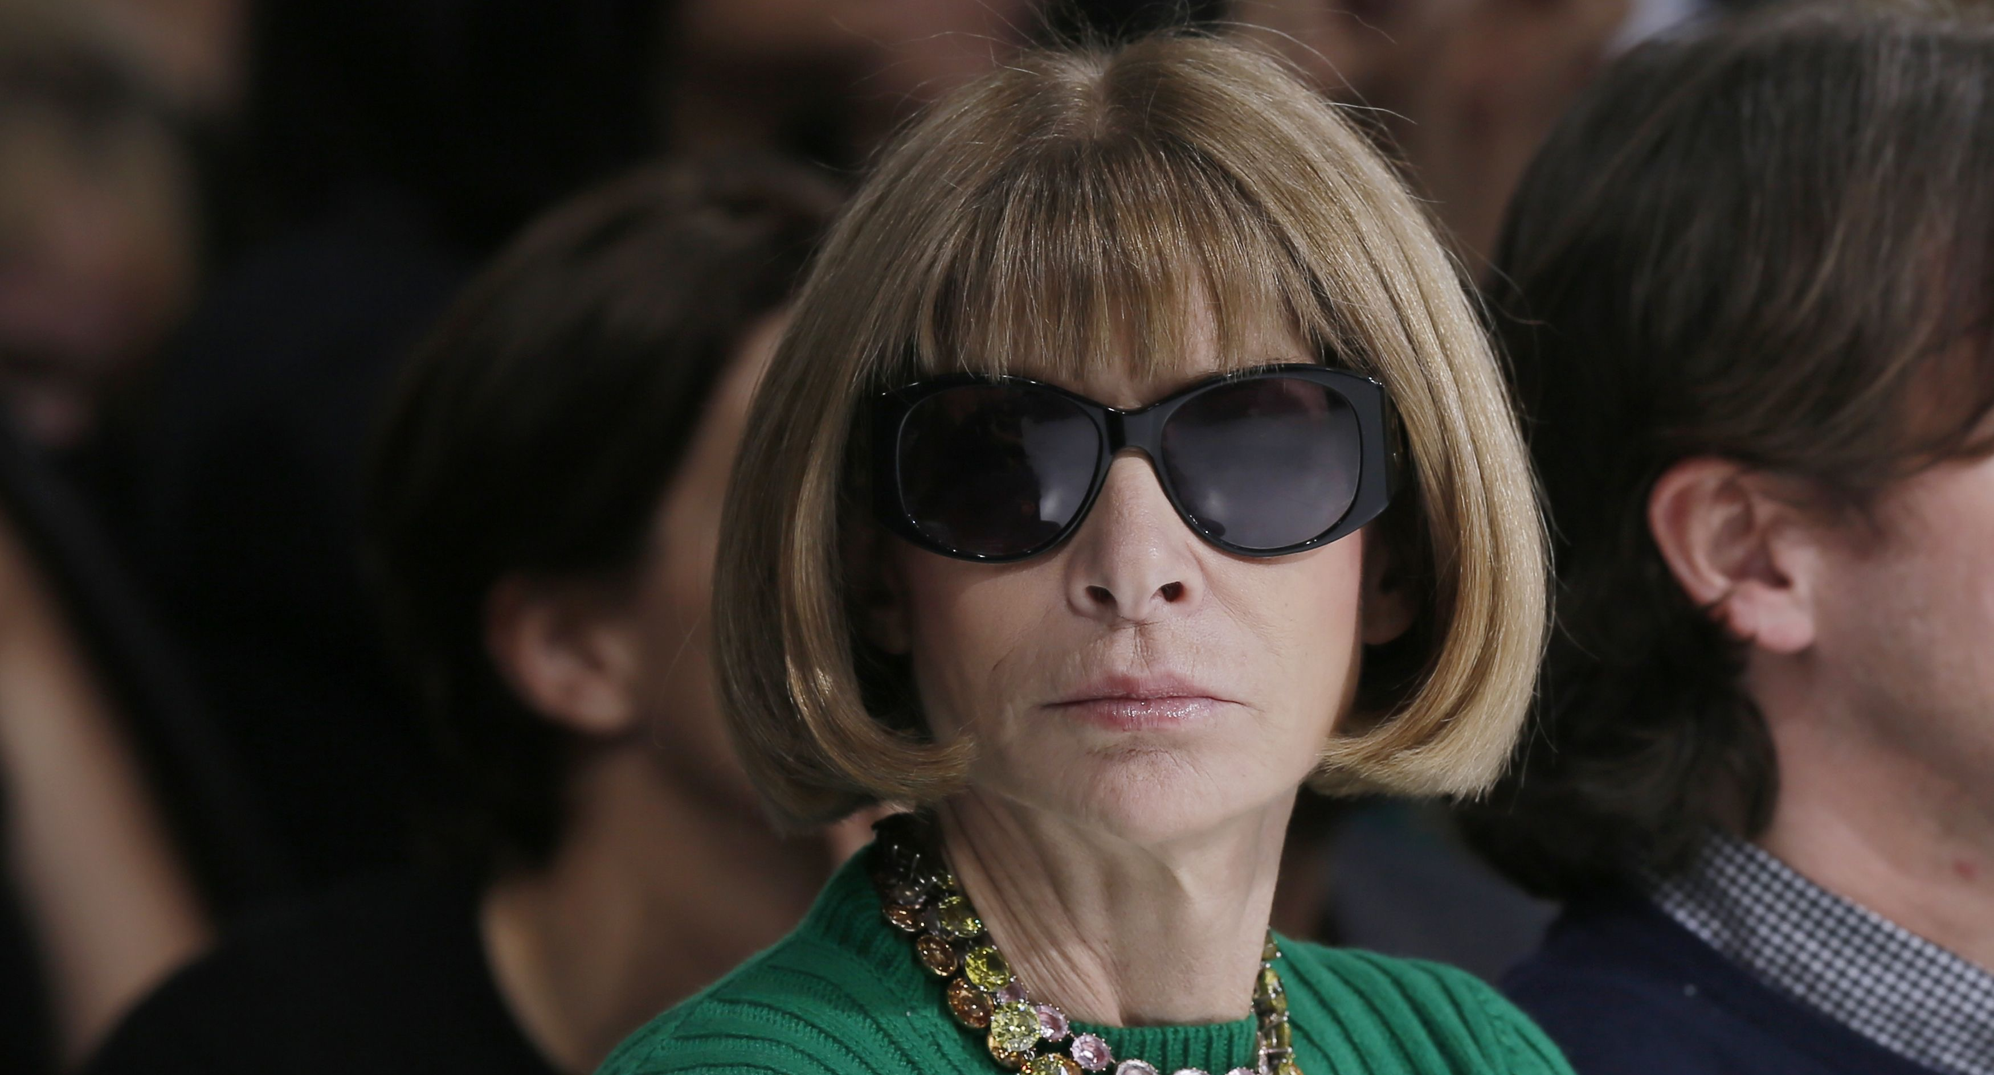
“You either know Fashion or you don’t”
anna wintour

Slide 13
“But if you don’t… Smart Closet knows for you”
smart closet team

Slide 14
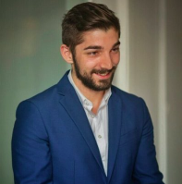

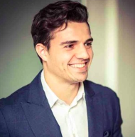
CONTACT
Javier Yuste García
(+34) 619 22 67 09
https://es.linkedin.com/in/javieryustegarcia
Fernando Álvarez-Uría Torres
(+34) 646 70 07 00
https://es.linkedin.com/in/fauria
Jesús San Román
(+34) 619 40 71 87
https://es.linkedin.com/in/jesussanromangarcia/es

